Slide 1



A picture is worth a thousand asserts

Slide 2


Team Members
Ahmed Gamal
Reem Emad
Taher Mohamed
Omar Mohamed
Supervised By : Dr. Ahmed Hamdy
Sponsored By :

Slide 3









Agenda

Slide 4

Motivation

Slide 5

Motivation
Visual testing is essential in the development lifecycle.

Slide 6
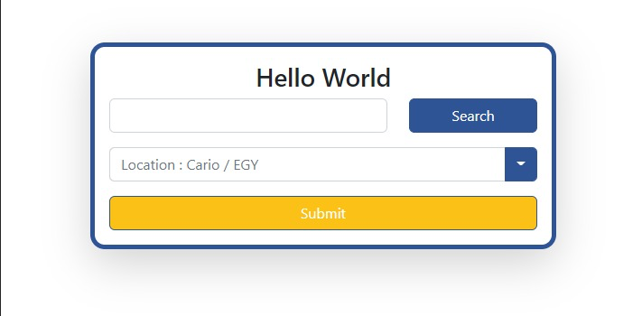
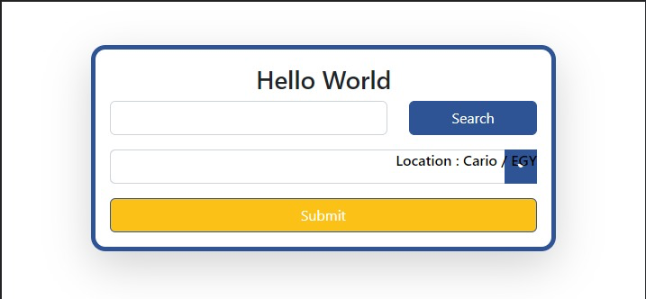
Motivation
Visual testing is essential in the development lifecycle.
Visual bugs may influence system functionality.

Slide 7

Motivation
Visual testing is essential in the development lifecycle.
Visual bugs may influence system functionality.
Manual visual testing is time-consuming.

Slide 8
Motivation
Visual testing is essential in the development lifecycle.
Visual bugs may influence system functionality.
Manual visual testing is time-consuming.
Visual testing tools use pixel-by-pixel comparison.

Slide 9

Motivation
Visual testing is essential in the development lifecycle.
Visual bugs may influence system functionality.
Manual visual testing is time-consuming.
Visual testing tools use pixel-by-pixel comparison.
Desktop visual testing tools are sparse and not mature enough.

Slide 10

Problem Definition

Slide 11
Problem Definition
Design and develop visual testing tool that:
Do component / widget comparison.
Detect visual bugs regrardless of the screen size.
Have configurable tolerance to allow changes in some regions.
Have friendly user interface for visual bug reporting.

Slide 12

Market and Literature Survey

Slide 13



Market Survey
Notes:
https://duotone.shapefactory.co/?i=-HH3cGeAC4o&f=3fc7ff&t=2c0058&q=_
https://duotone.shapefactory.co/?f=3fc7ff&t=2c0058&q=_

Slide 14




Web and mobile
Commercial software
Paid
Pros: Highlights the visual changes by each pull request on GitHub
Cons: pixel by pixel comparison
Notes:
https://storyset.com/illustration/meditation/bro
https://duotone.shapefactory.co/?i=-HH3cGeAC4o&f=3fc7ff&t=2c0058&q=_

Slide 15




Web, desktop, and mobile
Commercial software
Paid
Pros: integrate tests with Cypress
Cons: can’t handle dynamic content
Notes:
https://duotone.shapefactory.co/?i=roZgc7SXXmI&f=3fc7ff&t=2c0058&q=_

Slide 16
Literature Survey
Object detection
Use DOM
Deep learning approaches ( YOLO and RCNN )
Object Matching and comparison
Pixel by pixel
Extract key points and descriptors like SIFT

Slide 17

Features

Slide 18


Features
Page shifting detection.

Slide 19

Features
Page shifting detection.
Page scaling detection.

Slide 20

Features
Page shifting detection.
Page scaling detection.
Object shifting detection.

Slide 21

Features
Page shifting detection.
Page scaling detection.
Object shifting detection.
Object scaling detection.

Slide 22

Features
Page shifting detection.
Page scaling detection.
Object shifting detection.
Object scaling detection.
Object change detection.

Slide 23


Features
Page shifting detection.
Page scaling detection.
Object shifting detection.
Object scaling detection.
Object change detection.
Color change detection.

Slide 24

Features
Page shifting detection.
Page scaling detection.
Object shifting detection.
Object scaling detection.
Object change detection.
Color change detection.
New object detection.

Slide 25

Features
Page shifting detection.
Page scaling detection.
Object shifting detection.
Object scaling detection.
Object change detection.
Color change detection.
New object detection.
Missing object detection.

Slide 26

Features
Page shifting detection.
Page scaling detection.
Object shifting detection.
Object scaling detection.
Object change detection.
Color change detection.
New object detection.
Missing object detection.
Ignore object.

Slide 27

Features
Page shifting detection.
Page scaling detection.
Object shifting detection.
Object scaling detection.
Object change detection.
Color change detection.
New object detection.
Missing object detection.
Ignore object.
Add tolerance to all the mentioned features.

Slide 28

System Architecture

Slide 29
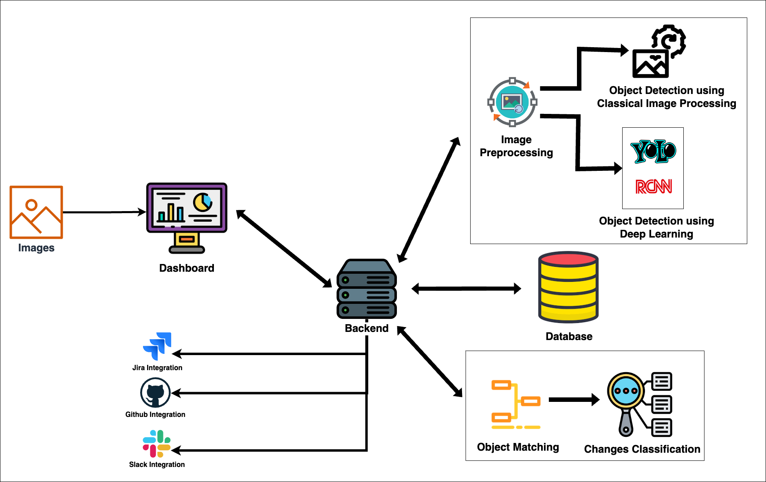
System Architecture

Slide 30

System Modules

Slide 31



Image Preprocessing
Detect page shifting and remove its effect.
Reference image
New image

Slide 32



Image Preprocessing
Detect page scaling and remove its effect.
Reference image
New image

Slide 33
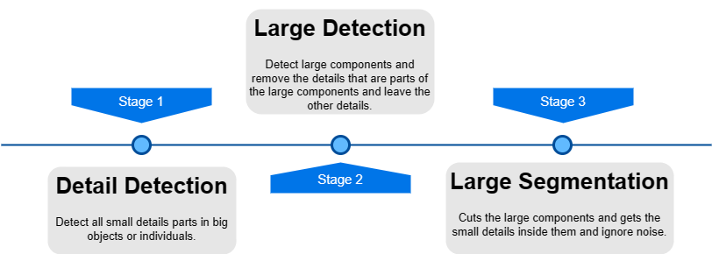
Classical Object Detection
Pipeline

Slide 34
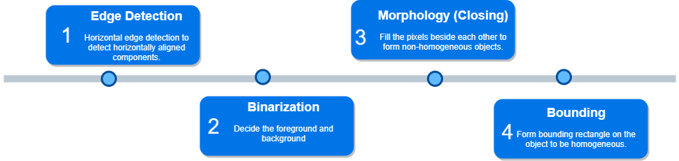
Classical Object Detection
Detail Detection

Slide 35

Classical Object Detection
Detail Detection

Slide 36
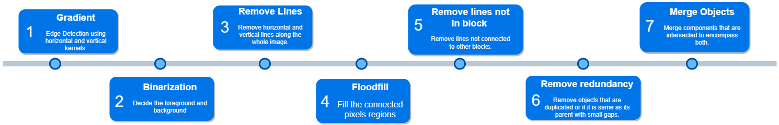
Classical Object Detection
Large Detection

Slide 37
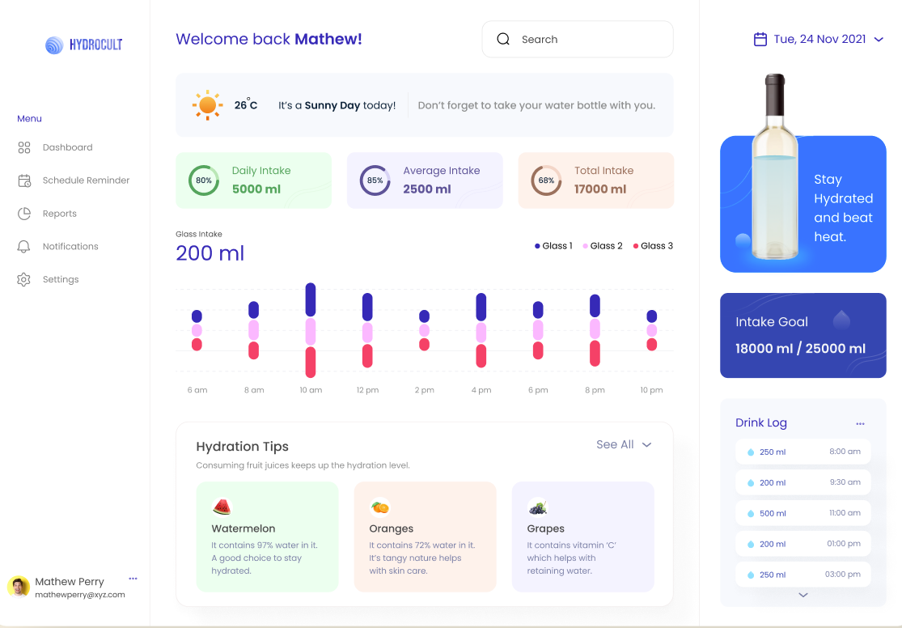
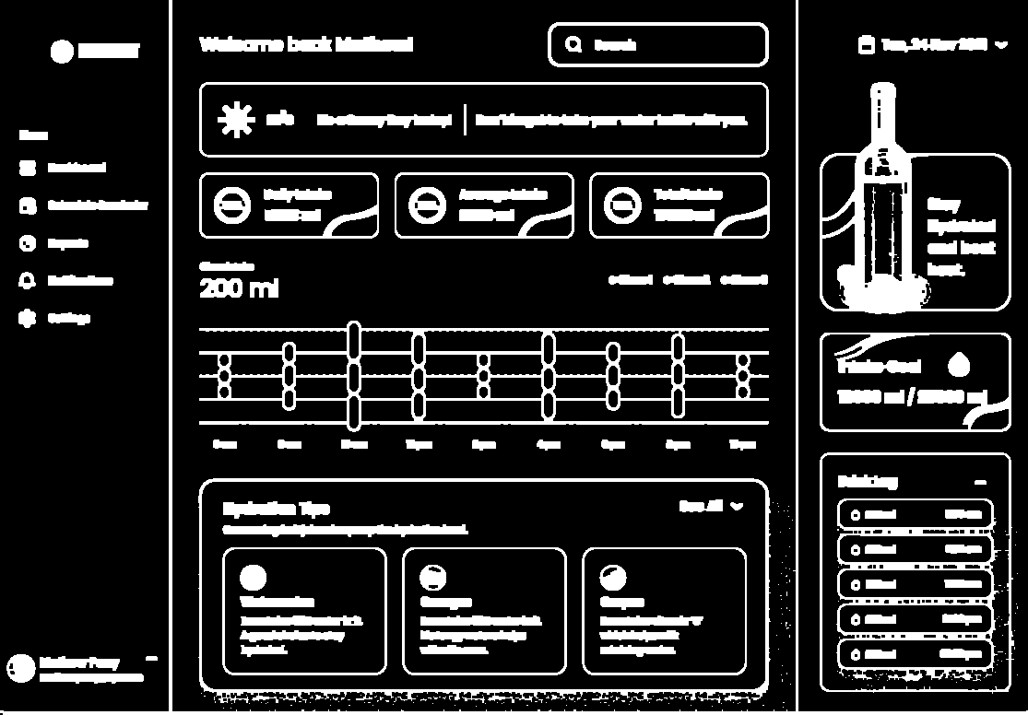
Classical Object Detection
Gradient and binarization

Slide 38
Classical Object Detection
Remove unwanted boundaries
Remove lines that are not part of the components but may disturb them.
Remove vertical and horizontal lines.
Remove lines that are taking the whole width/height.
Remove redundancy

Slide 39
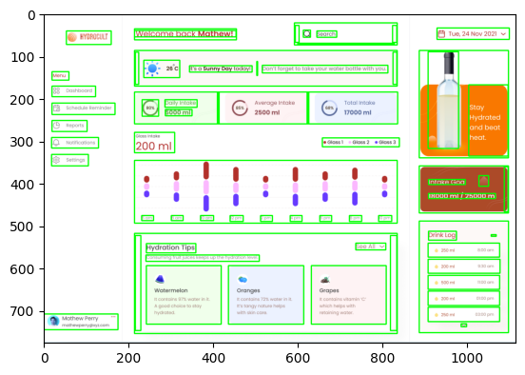
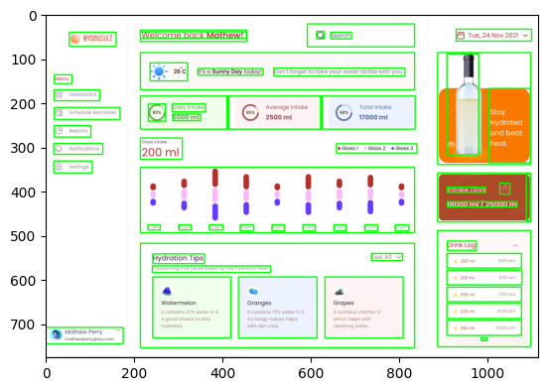
Classical Object Detection
Remove unwanted boundaries

Slide 40

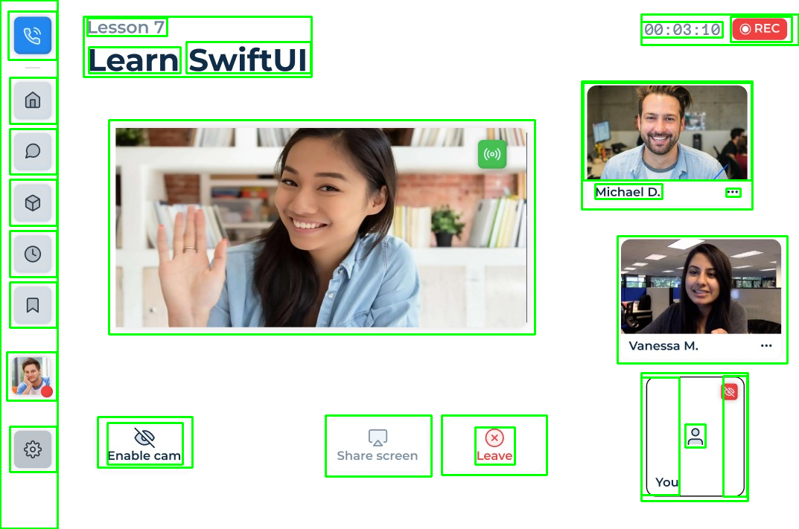
Classical Object Detection
Other Examples

Slide 41
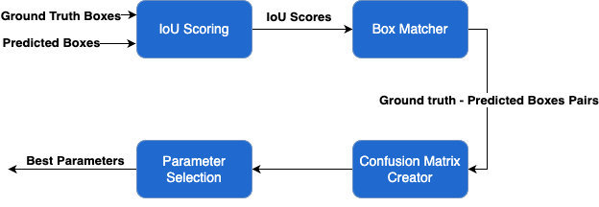
Parameter Search

Slide 42
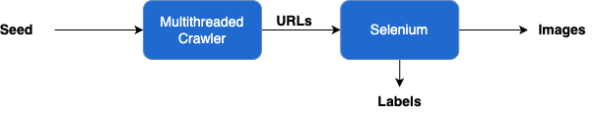
Dataset Creation

Slide 43
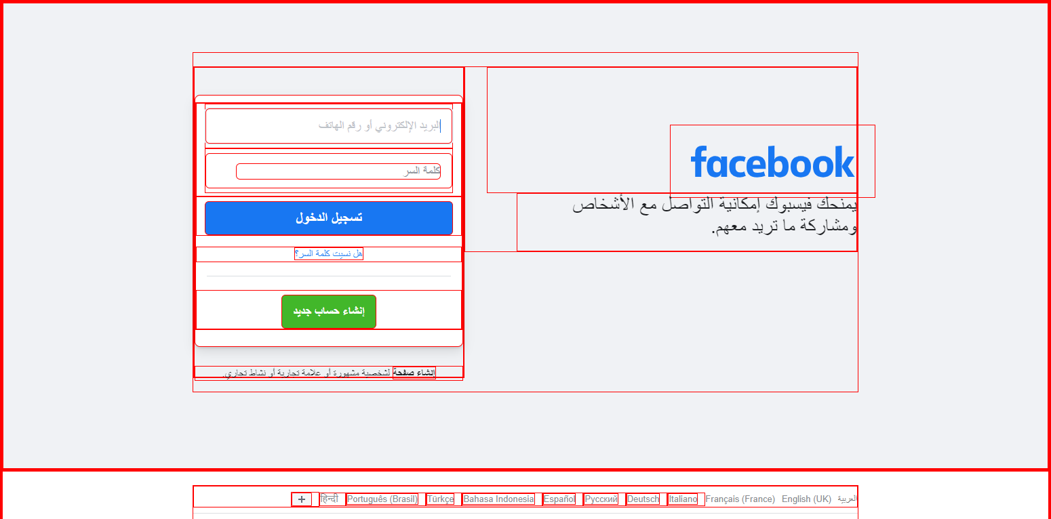
Dataset Creation
Results

Slide 44
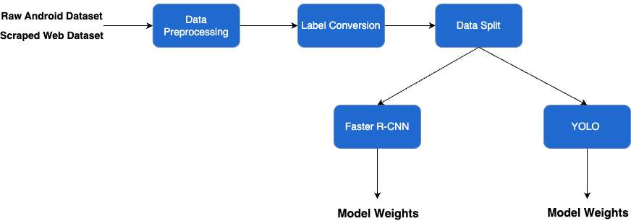
DL Object Detection
Training phase

Slide 45

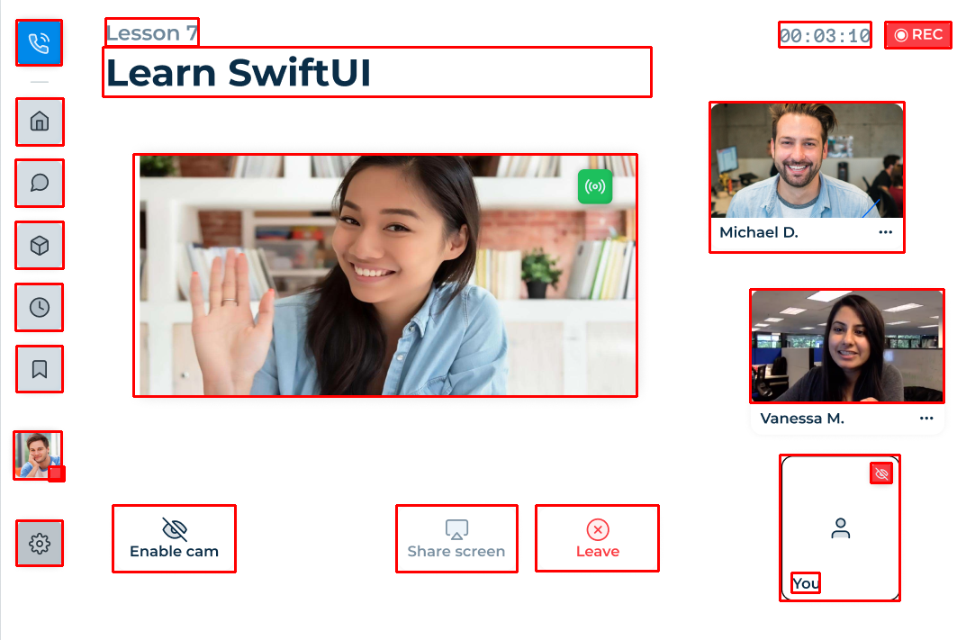
DL Object Detection
Results

Slide 46
DL Object Detection
Classical image processing vs DL
Classical Image processing
DL

Slide 47
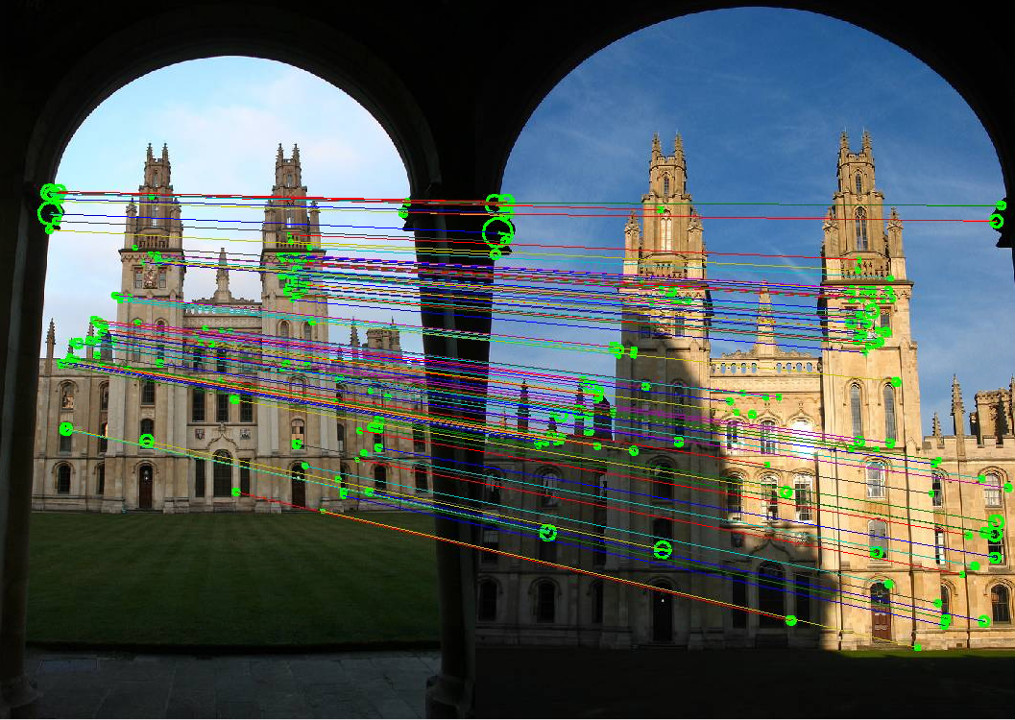
Similarity Measures
Write multiple similarity measures to be used in the analysis.
Exact matching measures
Template Matching
Pixel-by-pixel comparison
Color change measures
Object change measures
SIFT / KAZE / SSIM

Slide 48
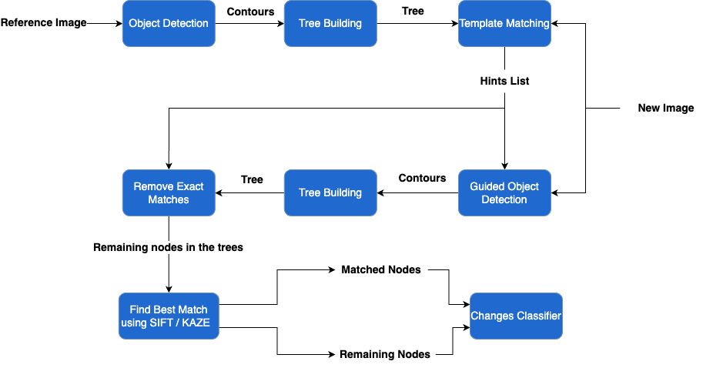
Object Matching

Slide 49


Object Matching
Reference and new images

Slide 50


Object Matching
After removing exact matches

Slide 51
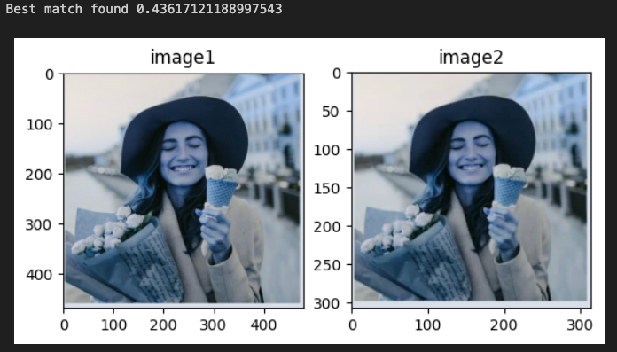
Object Matching
Best Matches

Slide 52


Object Matching
Remaining Objects

Slide 53
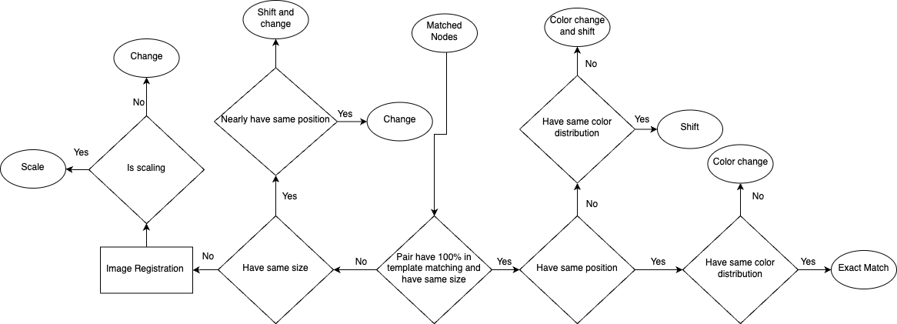
Changes Classification

Slide 54
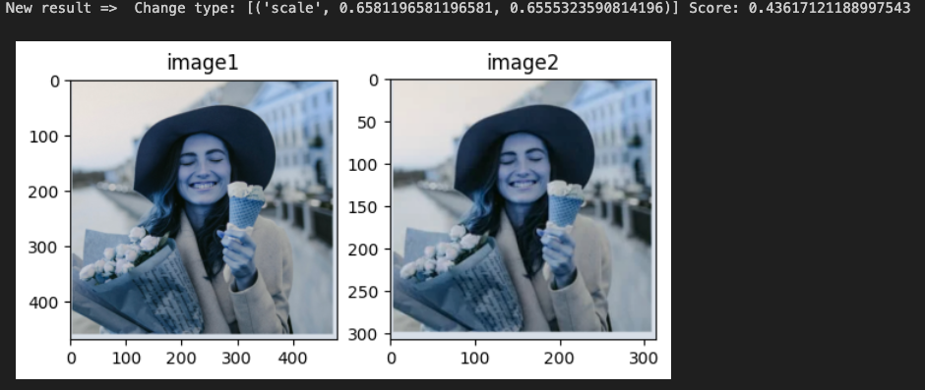

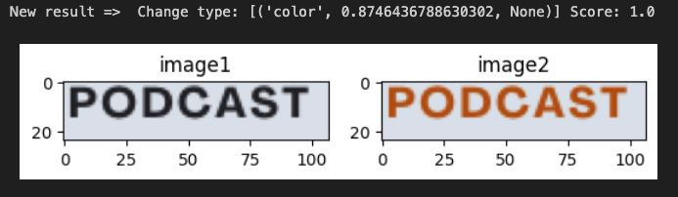
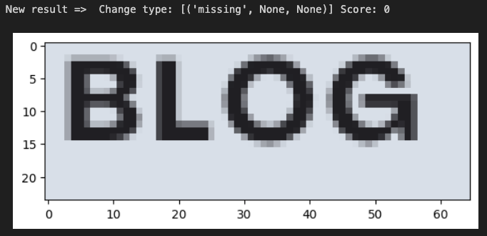
Changes Classification

Slide 55

Demo

Slide 56
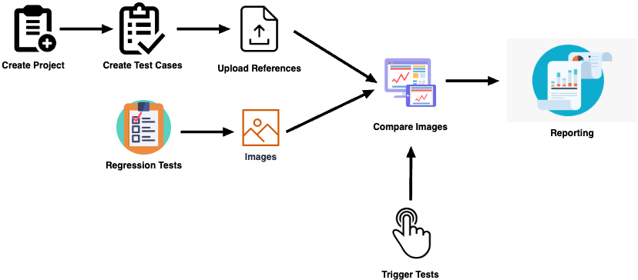
System Usage

Slide 57
Demo

Slide 58

Challenges and
Limitations

Slide 59

Challenges
Object definition.
Object detection with high accuracy.
Object matching.
Changes classification.
Dataset creation.
Hyperparameter tuning.

Slide 60

Limitations
Similarity measures don’t work well for low-resolution images.
Page scaling must not exceed 20% of the reference image size.
Hyperparameters may need to be changed for different domain-specific UIs.
To get the most out of the deep learning model we need a large labeled domain-specific dataset.

Slide 61

Conclusion

Slide 62
Conclusion
Our tool solves the common problems in the existing GUI testing tools.
Operate on the object level instead of the pixel level
Provide a strong tool for testing the GUI of desktop applications.
Allow some changes to be tolerated or ignored.

Slide 63

Future Work

Slide 64

Future Work
Improve object matching for low-resolution Images.
Produce more accurate bounding boxes in the dataset creation phase.
Use a machine learning model to classify the OS-dependent changes in small EDA icons.
Performance optimization to decrease runtime.
Add more integrations.

Slide 65
Client Feedback
"We are so excited about your deliverables! Your approach is object-based, rather than pixel-based, which is more convenient for our problems. The results you have achieved in one year of hard work are very promising, and we are going to build upon them to reach a fully deployed solution that bears the signature of your work!” -Sarah Ali, Software Quality Assurance Team Lead at Siemens EDA

Slide 66
Project Modules
Module | Ahned Gamal | Reem Emad | Taher Mohamed | Omar Mohamed | Ready-made %
Image Preprocessing |  |  |  | 100%
Classical Object Detection |  | 100%
Parameter Search | 100%
Dataset Creation |  |  |  | 75% | 25%
Deep Learning Object Detection | 75% |  |  |  | 25%
Similarity Measures |  |  |  | 75% | 25%
Object Matcher |  |  | 100%
Changes Classifier |  |  | 100%
Backend |  | 50% | 50%
Frontend | 50% |  |  | 50%

